Slide 1
Sales Evaluations On
The Look Ecommerce Based On Customer Behaviours
By Muhammad Hasan I

Slide 2
Questions
What products do the customers buy the most?
Which products have the most sales?
Which gender buys more products on The Look?

Slide 3
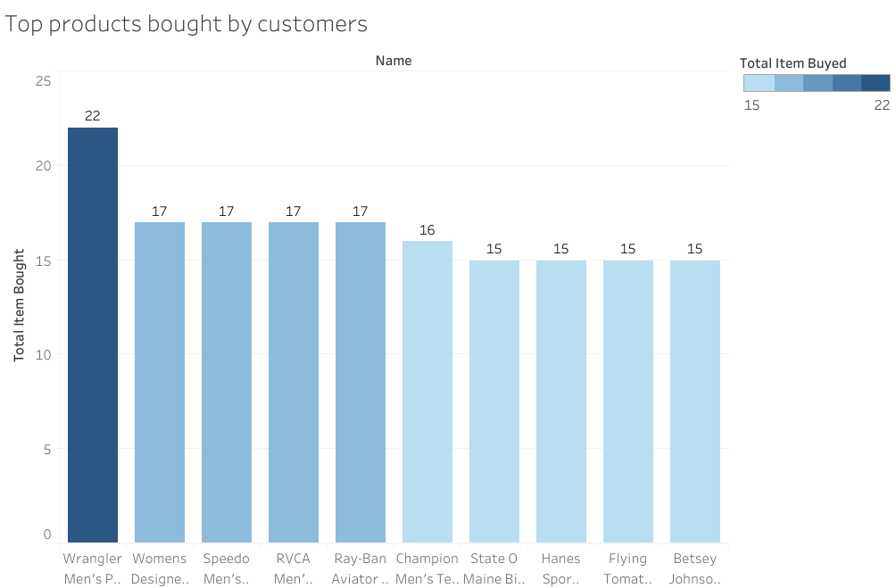
Here’s the top 10 products bought by the customers. The top products is Wrangler Men's Premium Performance Cowboy Cut Jean

Slide 4
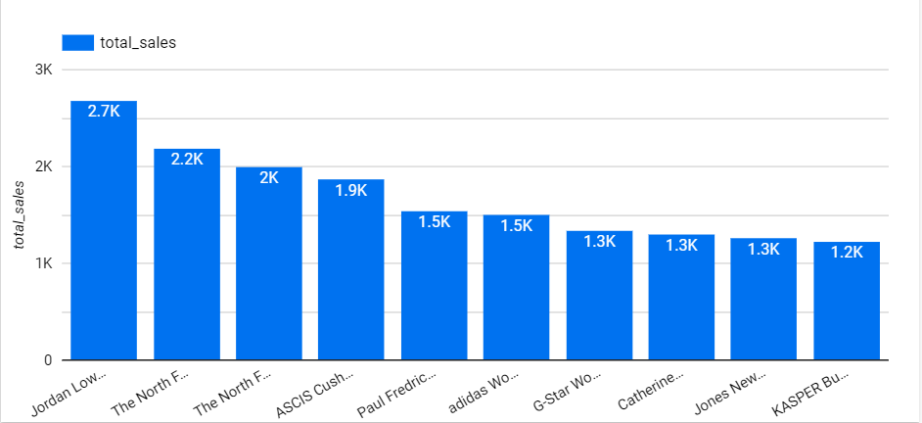
Top 10 products with the highest sales
The product with highest sales is Jordan Low Quarter Sock Style # 427411
with total sales 2.7K

Slide 5
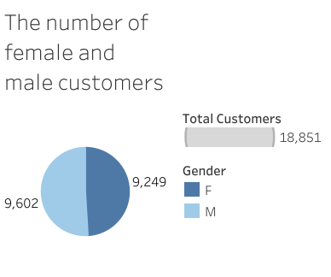
The female and male customers have a slightly different number

Slide 6
Table of interest
bigquery-public-data.thelook_ecommerce.orders
bigquery-public-data.thelook_ecommerce.order_items
bigquery-public-data.thelook_ecommerde.products

Slide 7
Queries
Top 10 items bought by customers
SELECT
DISTINCT products.name,
SUM(orders.num_of_item) AS total_item_buyed
FROM
bigquery-public-data.thelook_ecommerce.orders AS orders
JOIN
bigquery-public-data.thelook_ecommerce.order_items AS order_items
ON
orders.user_id = order_items.id
JOIN
bigquery-public-data.thelook_ecommerce.products AS products
ON
order_items.product_id = products.id
GROUP BY
products.name
ORDER BY
total_item_buyed DESC
LIMIT 10
Notes:
SELECT
DISTINCT products.name,
SUM(orders.num_of_item) AS total_item_buyed
FROM
bigquery-public-data.thelook_ecommerce.orders AS orders
JOIN
bigquery-public-data.thelook_ecommerce.order_items AS order_items
ON
orders.user_id = order_items.id
JOIN
bigquery-public-data.thelook_ecommerce.products AS products
ON
order_items.product_id = products.id
GROUP BY
products.name
ORDER BY
total_item_buyed DESC
LIMIT 10

Slide 8
Top products with the highest sales
SELECT
DISTINCT products.name,
SUM(orders.num_of_item) AS total_item_buyed,
order_items.sale_price * SUM(orders.num_of_item) AS total_sales
FROM
bigquery-public-data.thelook_ecommerce.orders AS orders
JOIN
bigquery-public-data.thelook_ecommerce.order_items AS order_items
ON
orders.user_id = order_items.id
JOIN
bigquery-public-data.thelook_ecommerce.products AS products
ON
order_items.product_id = products.id
GROUP BY
products.name, order_items.sale_price
ORDER BY
total_sales DESC
LIMIT 10

Slide 9
Number of female and male customers
SELECT
gender,
COUNT(gender)
FROM
bigquery-public-data.thelook_ecommerce.orders
GROUP BY
gender

